Slide 1
Computing with Heterogeneous Specimen Occurrence Data for Global Scale Analyses
CJ Grady
University of Kansas
Biotaphy / Lifemapper

Slide 2
Key Points
Easy to use, flexible tools for data cleaning
How Biotaphy facilitates scaling
What you can do with cleaned data
Outputs of computations
Community additions
What’s next

Slide 3
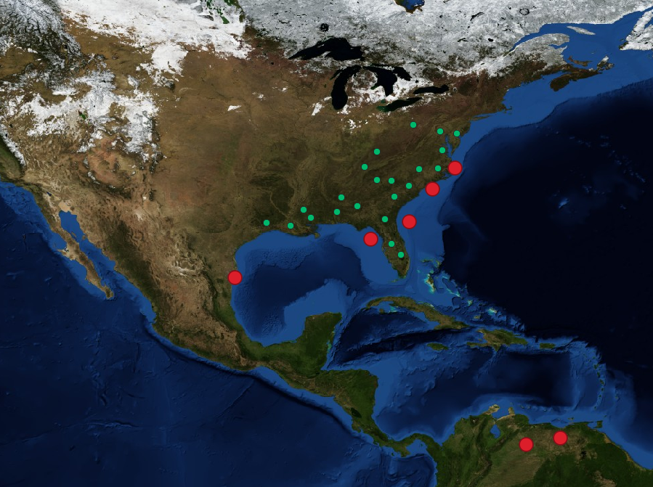
Cleaning Data for a Few Data Points is Easy*
*Relatively…
Hundreds or thousands of data points can be curated by hand
Species knowledge and individual validation feasible

Slide 4



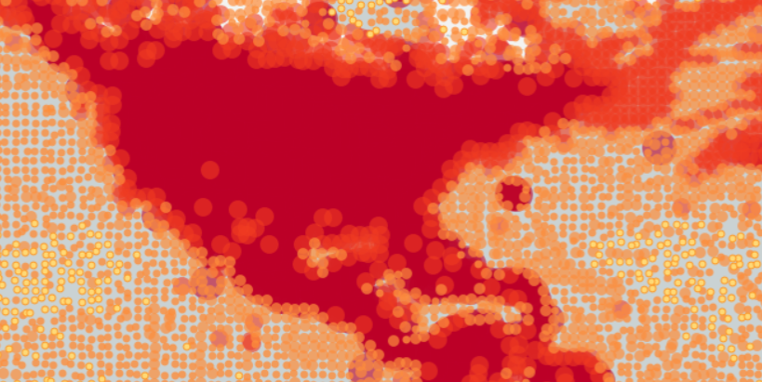
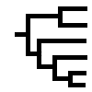
Cleaning Lots of Points is Hard!
Multiple data sources in multiple formats
DWCA, CSV, JSON – maybe hundreds of files
Hundreds of thousands to millions to hundreds of millions of points
Not an expert on all of the species

Slide 5
Introducing: lmpy
http://github.com/lifemapper/lmpy
Python Library
Methods and tools we use for data cleaning and computations
Resource usage and / or speed optimized
Tools for simplifying common workflows we feel can be useful for the larger community
The same tools we use in our installations

Slide 6
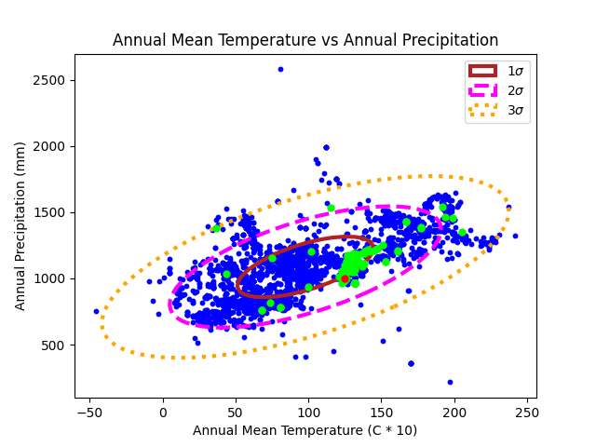
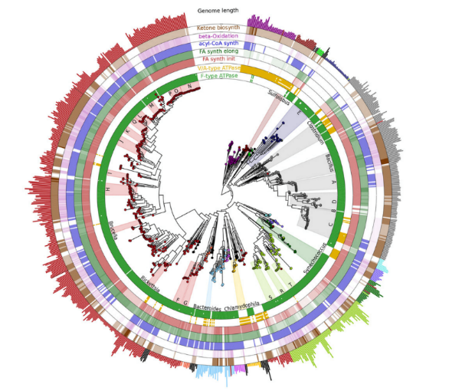
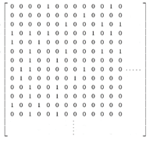
Lmpy features
{ … }
Species,X,Y
Species A,12,45
Species A,17,44
…
Process multiple data files in multiple formats
Text-delimited values (CSV or TSV)
JSON
Darwin Core Archives
Extendible
Matrix and Tree tools
Sorting and grouping points
Multi-species statistics
PAM randomization and null model computations

Slide 7
Lmpy Data Wranglers
Filters
Decimal precision
Intersecting / disjoint geometries
Minimum number of points
Bounding box
Provider flags
Attribute filters
Modifiers
Accepted taxon name
Common formatting
Coordinate re-projection
Combine / manipulate fields

Slide 8
Example: Squirrels
Data from multiple sources
Darwin Core Archive from GBIF
Multiple JSON files from iDigBio API
CSV file from KU Mammals Specify collection export
Data wranglers
Use provider flags to filter records
Ensure that we have the (GBIF) accepted taxon name
Convert to a common format
Filter records with low coordinate precision
Remove duplicate localities for each species
Only keep species with at least 12 records

Slide 9
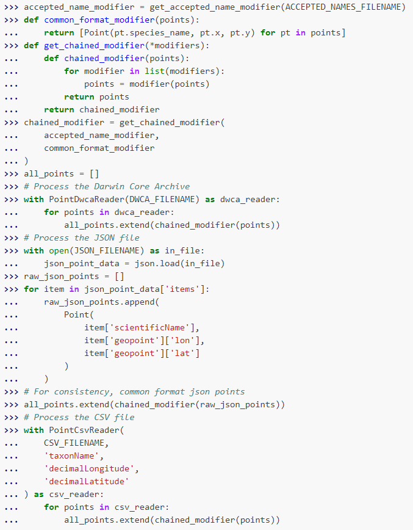
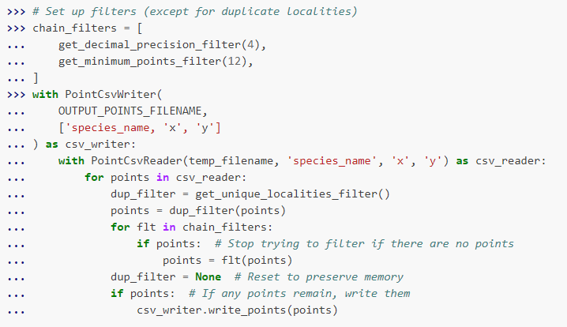
The Only Code Slide

Slide 10
Example Data cleaning Workflow
Darwin Core Archive
Filter using provider flags
Fill in accepted name
Convert to common format
Aggregate points
JSON File
Filter using provider flags
Fill in accepted name
Convert to common format
CSV File
Fill in accepted name
Convert to common format
Combined Data CSV

Slide 11
Example Data cleaning Workflow
Combined Data CSV
Filter low decimal precision points
Filter by geometry
Filter species with too few points
Assemble dataset
Cleaned Dataset

Slide 12
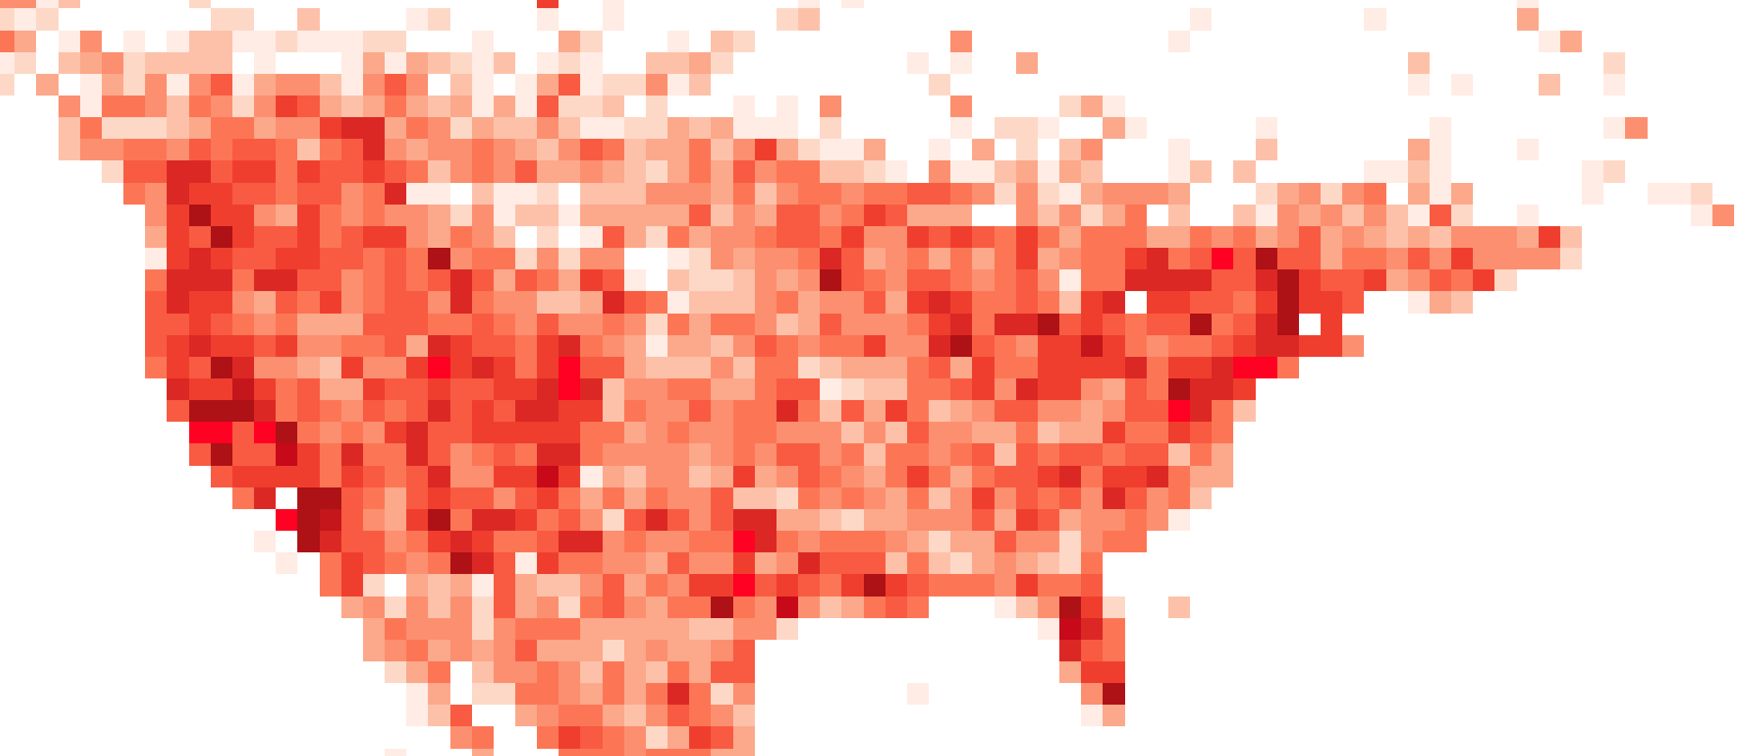
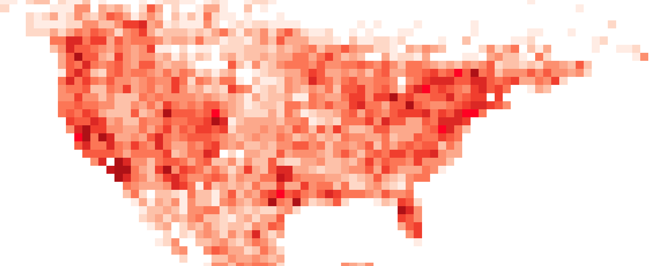
Before and After
1.1 million points
477k points

Slide 13
If You Want to Dig Into the Code
Library documentation at: https://lifemapper.github.io/lmpy
Tutorial at: https://lifemapper.github.io/lmpy/tutorial/data_cleaning.html#aggregate-and-clean-multiple-data-files
I would be more than happy to help you use the library, email me at: cjgrady@ku.edu

Slide 14
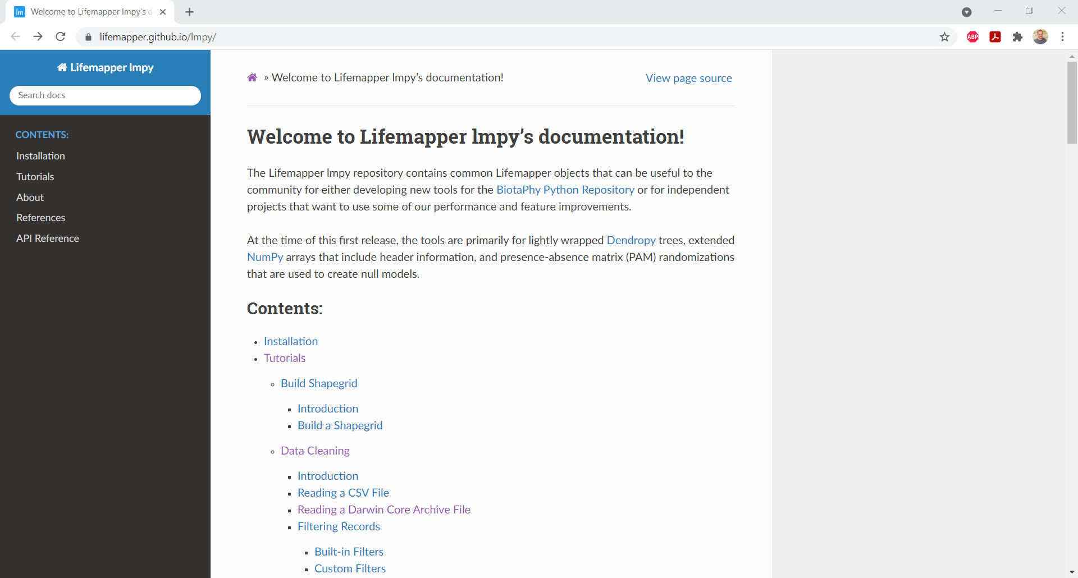

Slide 15
Using the Cleaned Data - Biotaphy

Slide 16
Biotaphy Workflows
Create Model Mask
Model Mask
Model Scenario
CSV Points
Create Shapefile
Catalog Occ
Create Model
Points Shapefile
Model Ruleset
Create Projection Mask
Projection Mask
Catalog Proj
Projection Scenario
Create Projection
Projection Tiff
Presence Absence Vector
Index PAV
Intersect
Notes:
The SDM workflow can be though of in three pieces:
Occurrence set creation
Model ruleset creation
Projection creation

Slide 17
Biotaphy Workflows
CSV Points
Create Shapefile
Catalog Occ
Model Scenario
Create Model Mask
Model Mask
Points Shapefile
Create Model
Model Ruleset
Create Projection Mask
Projection Mask
Catalog Proj
Projection Scenario
Create Projection
Projection Tiff
Presence Absence Vector
Index PAV
Intersect
Notes:
The SDM workflow can be though of in three pieces:
Occurrence set creation
Model ruleset creation
Projection creation

Slide 18
Biotaphy Workflows
Occurrence Set
Model
Projection
Notes:
We will simplify the representation of these pieces by creating single objects for each.
For a single species, one workflow is not terribly difficult to compute

Slide 19
Biotaphy Workflows
Notes:
But if you have multiple species, such as for a small clade, the size of the computations starts to grow

Slide 20
Biotaphy Workflows
Notes:
And if you have many species, for a larger clade, the computations start to become significant and may be too much for a desktop machine.

Slide 21
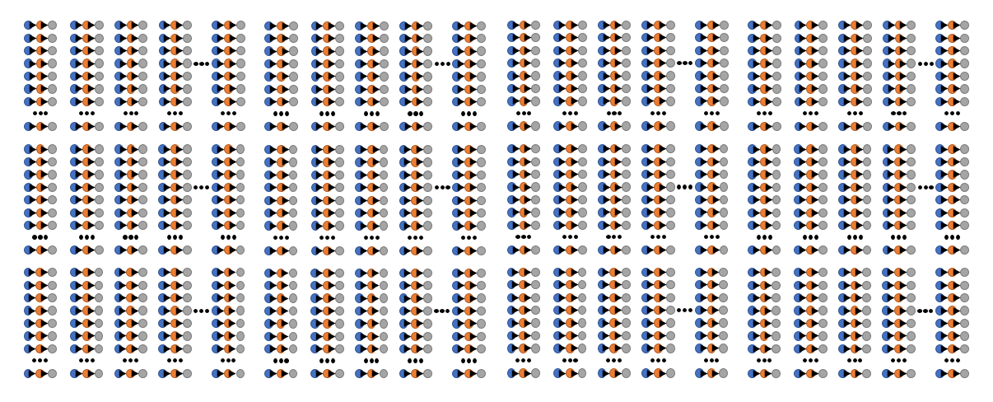
Biotaphy Workflows
Notes:
What if you have a larger clade, or entire family that you want to create SDMs for. If you are using higher resolution climate data, these computations could take months for a single machine, especially if you want to explore different algorithm parameters.

Slide 22
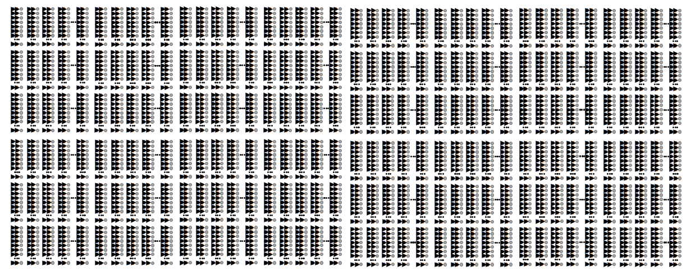
Biotaphy Workflows
Notes:
Now imagine that you are interested in an even larger clade or taxonomic group, such as all flora in North America, and / or you want to explore multiple algorithm configurations and predicted climate conditions. It is easy to imagine scenarios where you would have tens or hundreds of thousands (or millions) of SDM workflows to compute. Even with powerful desktop computers, the computations could take a very long time. This is where cluster and super computing become very important.

Slide 23
Scaling Takes Time
Millions of SDMs take a long time
Multi-species Statistics take a long time too
PAM randomizations using traditional methods take many minutes to hours and / or require huge quantities of resources – try that 10,000 times for a null model!
We have developed a method that operates in a fraction of the time with a fraction of the resources – and you can try it with lmpy!
We scale all of the computations across a compute cluster to reduce the overall time required

Slide 24
Demo
Biotaphy workflows currently available

Slide 25
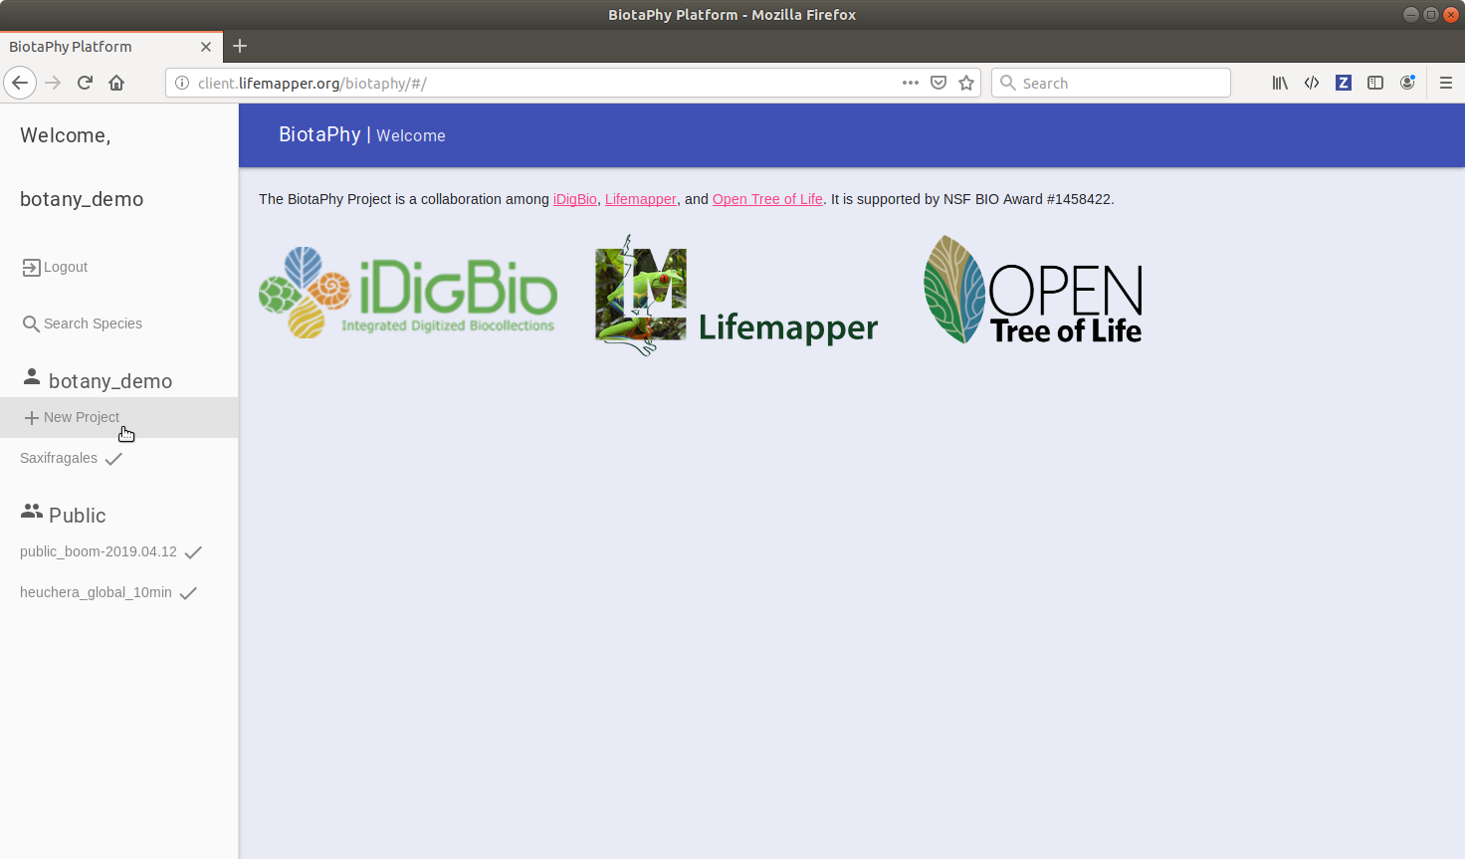
Notes:
To submit a project through the BiotaPhy web UI, first navigate to http://client.lifemapper.org/biotaphy/

Slide 26
Notes:
The UI lists available projects in the left side pane. Both those of the user and the publicly available projects can be selected. This is also where the New Project option is located. The main canvas updates to display the selected project or options for creating a new project as they are made available.

Slide 27
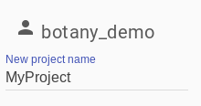
Notes:
Selecting new project first gives you a text box to enter a name for it

Slide 28
Occurrence Data
Four methods
Species names
Finds accepted names via GBIF
Uses data from iDigBio
Gets a tree from Open Tree
Taxonomic search
Uses data from iDigBio
Gets a tree from Open Tree
Existing data
CSV upload
Notes:
There are four options for selecting occurrence data for your project. You can specify a set of species names, drill down through taxonomy, select existing occurrence data, or you can upload your own data in csv format.
If you specify species names or perform a taxonomic search, occurrence data is retrieved from iDigBio and a phylogenetic tree is retrieved from Open Tree.

Slide 29
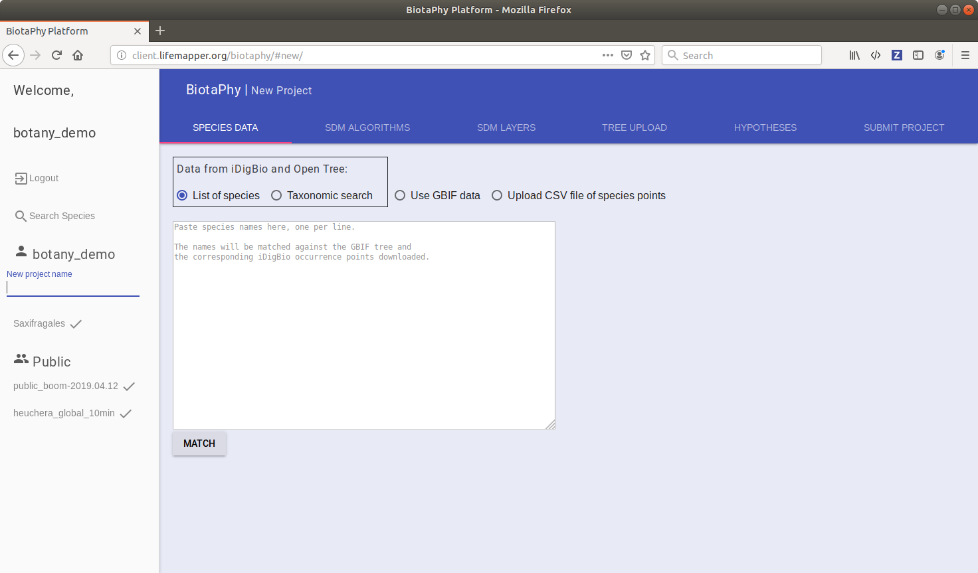
Notes:
After selecting new project, select the SPECIES DATA tab. The method for specifying occurrence data can be selected via radio button. For this example, we will specify a set of species names.

Slide 30
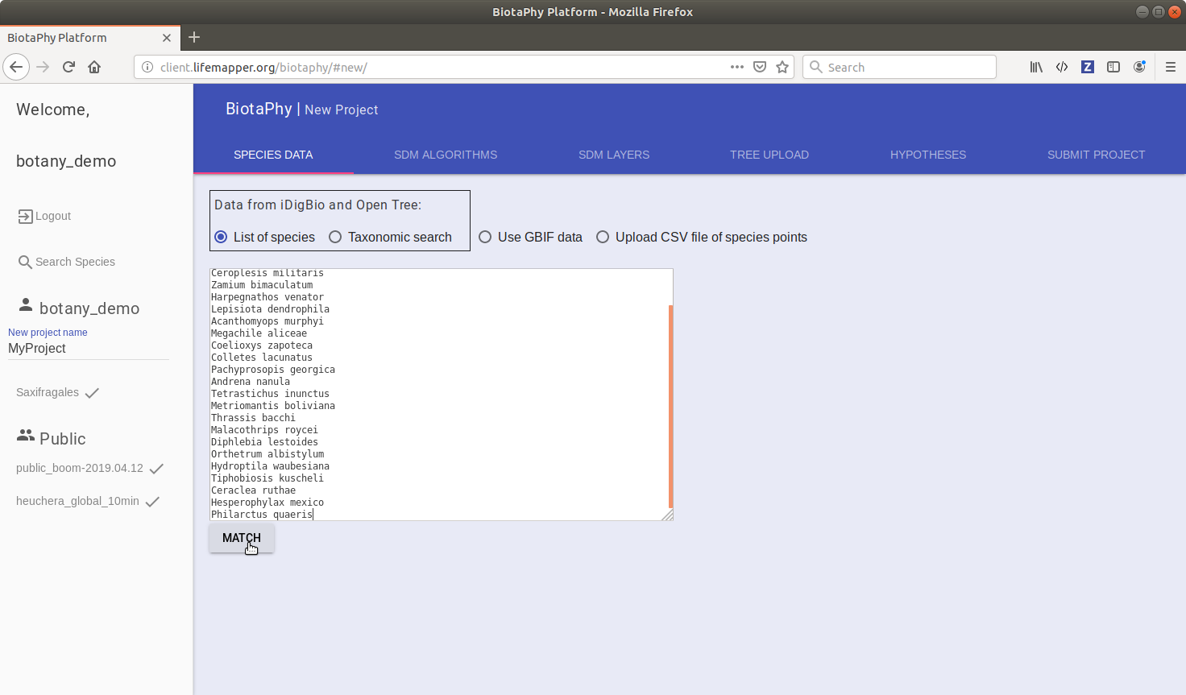
Notes:
Type or paste your species names in the text box and click the Match button. Doing so will send a query to GBIF services to get the accepted names for the species you entered, then occurrence counts will be retrieved from iDigBio (the data will be retrieved after the project is submitted), and then a query will be sent to Open Tree to construct a tree for the specified species.

Slide 31
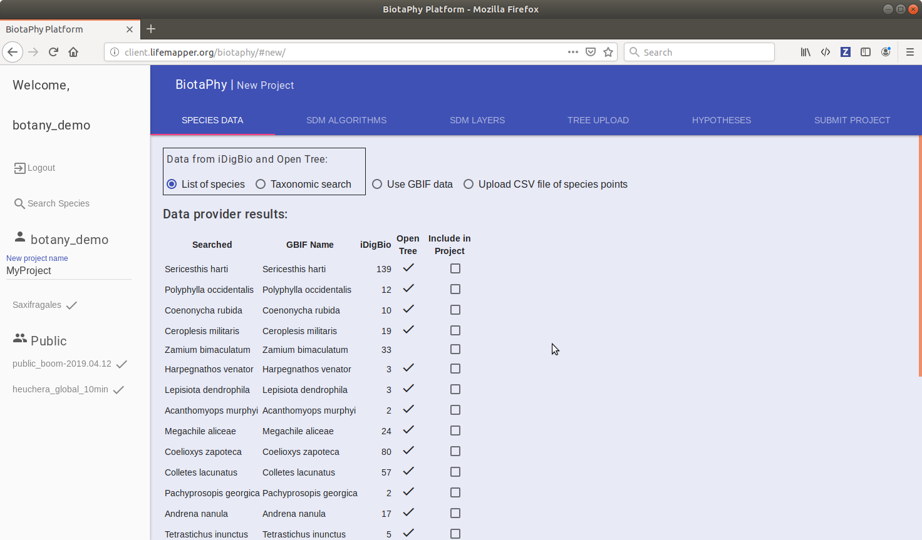
Notes:
After the queries have been made and returned, you will be presented with a table showing the results of those queries. The “Searched” column represents the strings you provided, GBIF Name is for the retrieved accepted names from GBIF, the iDigBio column represents the count of matching data points in iDigBio and the Open Tree column indicates if the species is available in Open Tree. The final column let’s you select which species you would like to include in your project.

Slide 32
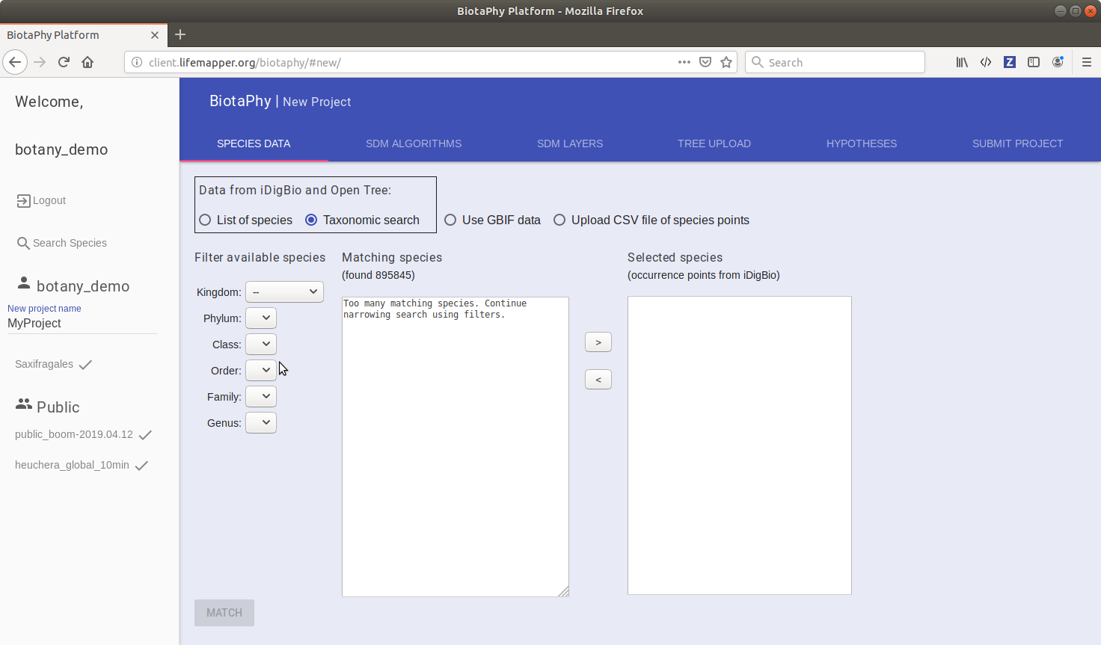
Notes:
This next example will go through the process of specifying occurrence data via taxonomic search. The drop down boxes on the left side of the canvas allow you to drill down through the taxonomy. When there are few enough species that match your parameters, they will be displayed in the matching species box

Slide 33
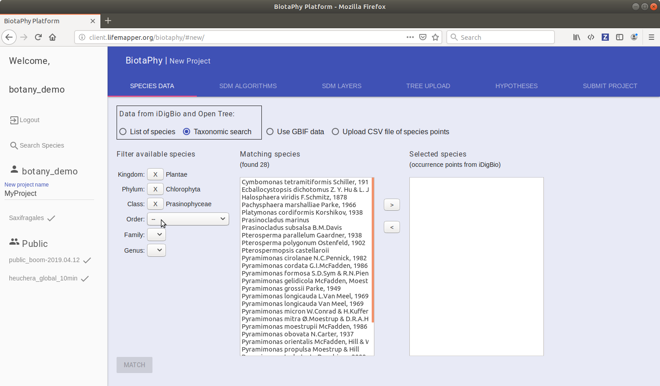
Notes:
Here we have specified Kingdom, Phylum, and Class to narrow down our results to 28.

Slide 34
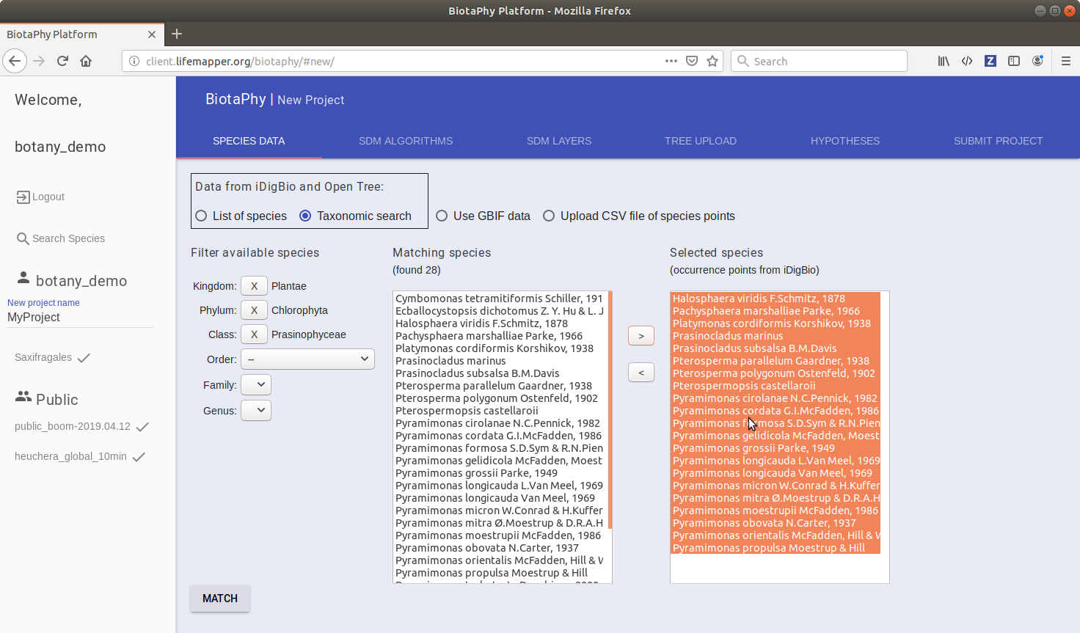
Notes:
You will then select the results you want and click on the right arrow to send them to the selected species. You can remove species from that list by selecting them and clicking the left arrow.

Slide 35
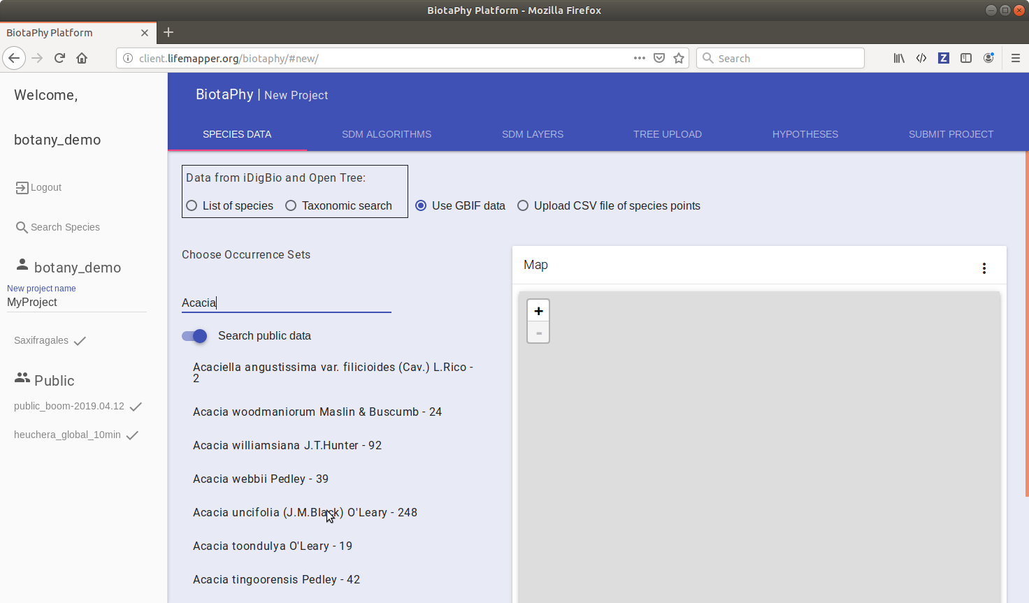
Notes:
The third way to specify occurrence data is by selecting data that already exists in our system. Select the “Use GBIF data” radio button and begin typing the species name. Matching results will fill the auto complete box and you can select the species you want to include

Slide 36
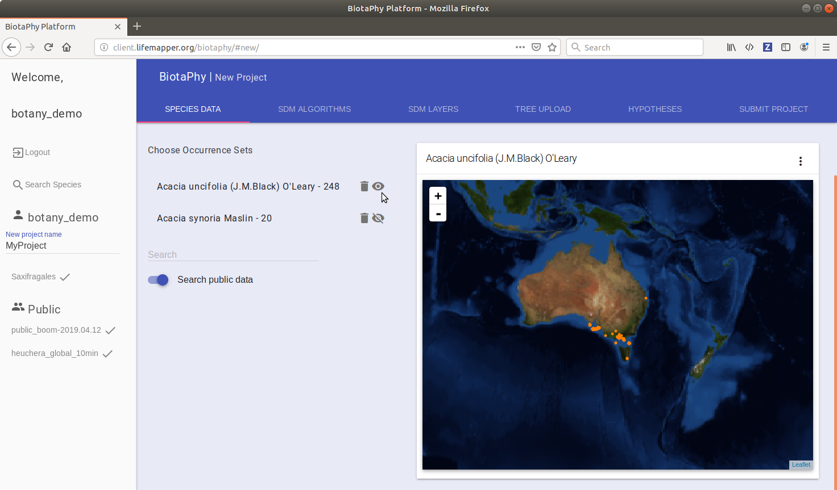
Notes:
When you select a species, a map of the occurrence data will be displayed. You can repeat the process to include data for multiple species. You can remove species from the project by clicking the trash can icon by the species name. The “eye” icon indicates which species is displayed in the map.

Slide 37
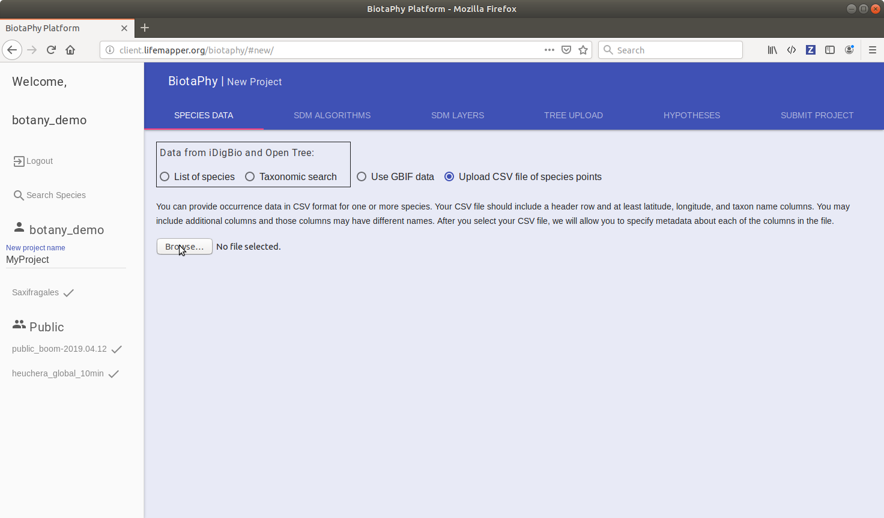
Notes:
Finally, you can submit your own csv of occurrence data. Do this by selecting the “Upload CSV file of species points” radio button. Your csv data should be grouped, so all of species A are together followed by species B data, then species C, etc

Slide 38
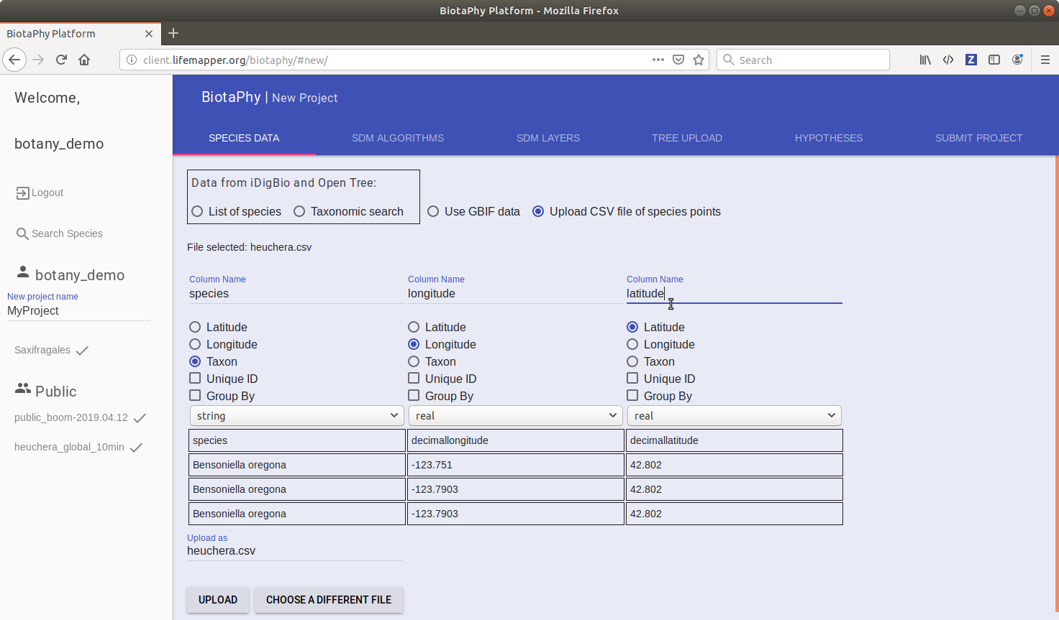
Notes:
When you select your occurrence data file, the UI will look at the first few lines and display them. You can then specify what data is in each column. Your data must include a column for longitude, latitude, and a taxon field

Slide 39
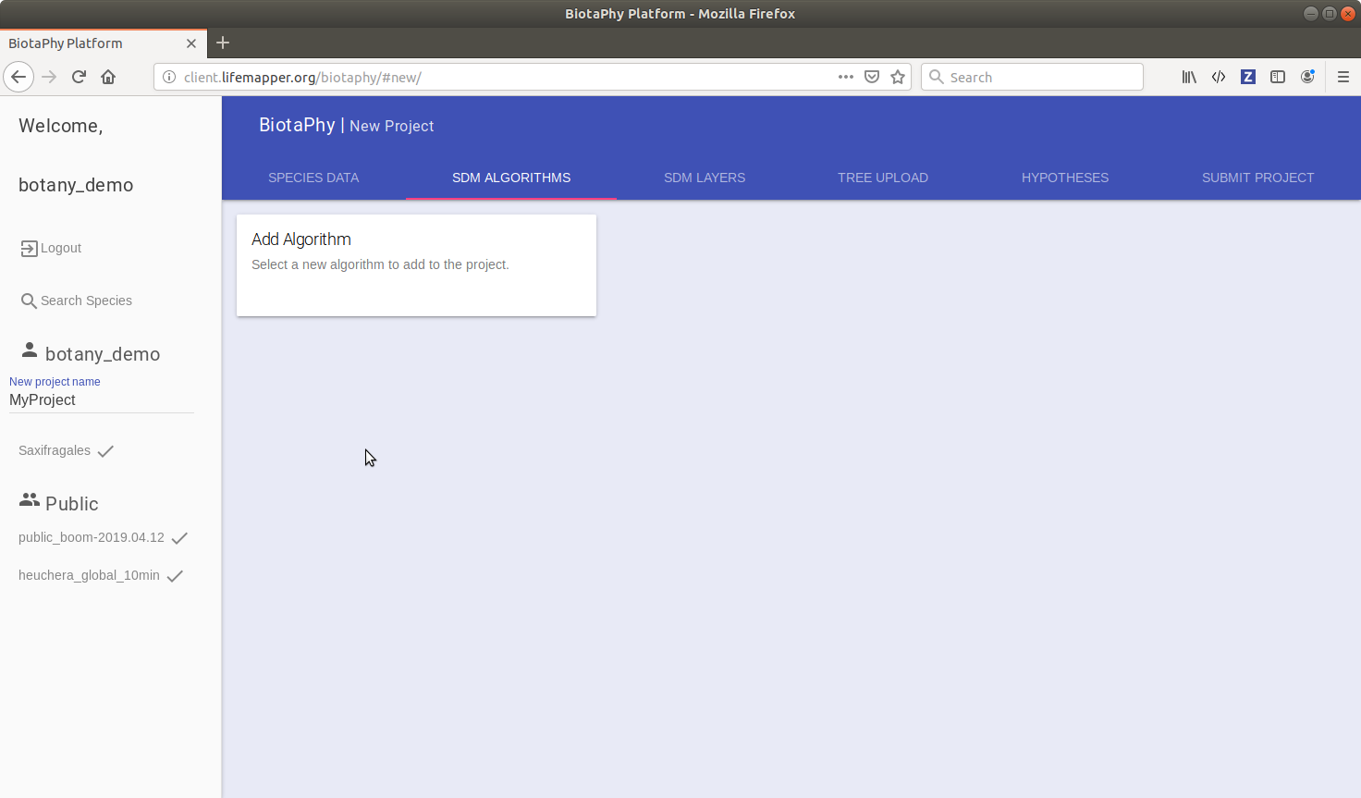
Notes:
After specifying your occurrence data, you will then add one or more algorithms for creating SDMs. Do this under the SDM Algorithms tab.

Slide 40
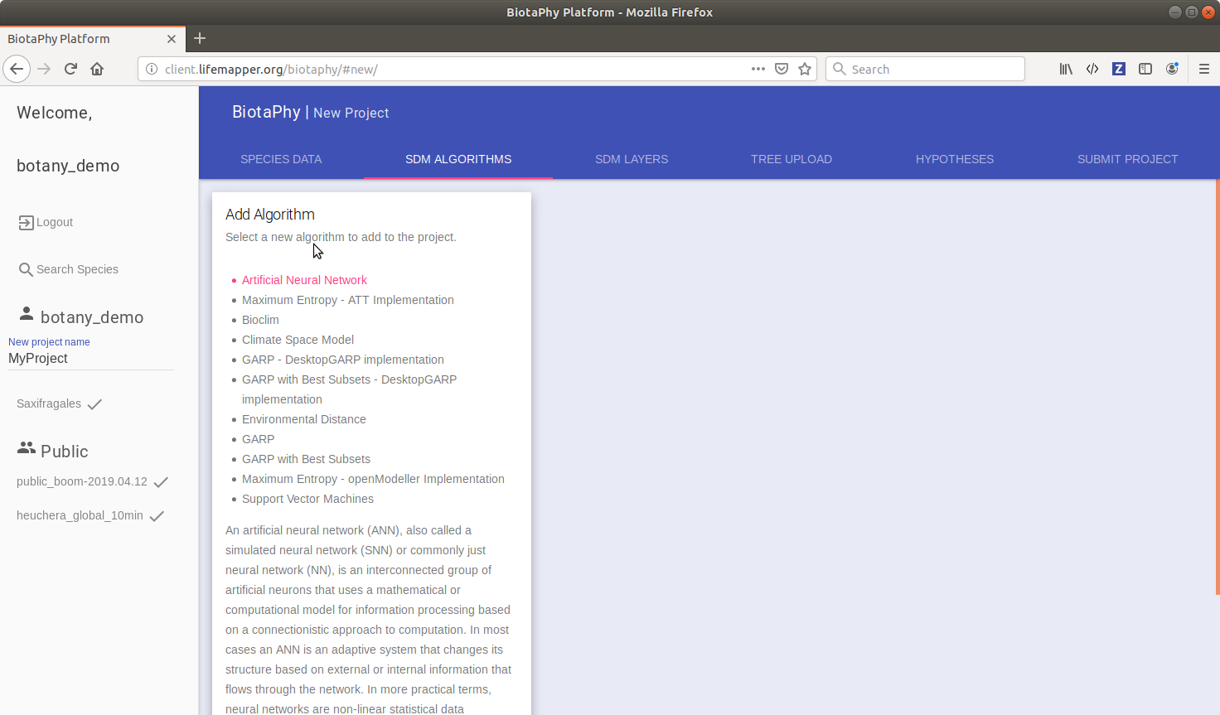
Notes:
Hover over the Add Algorithm card and a list of options will be displayed. Hovering over an option will tell you more about the algorithm. Select the one you would like to include

Slide 41
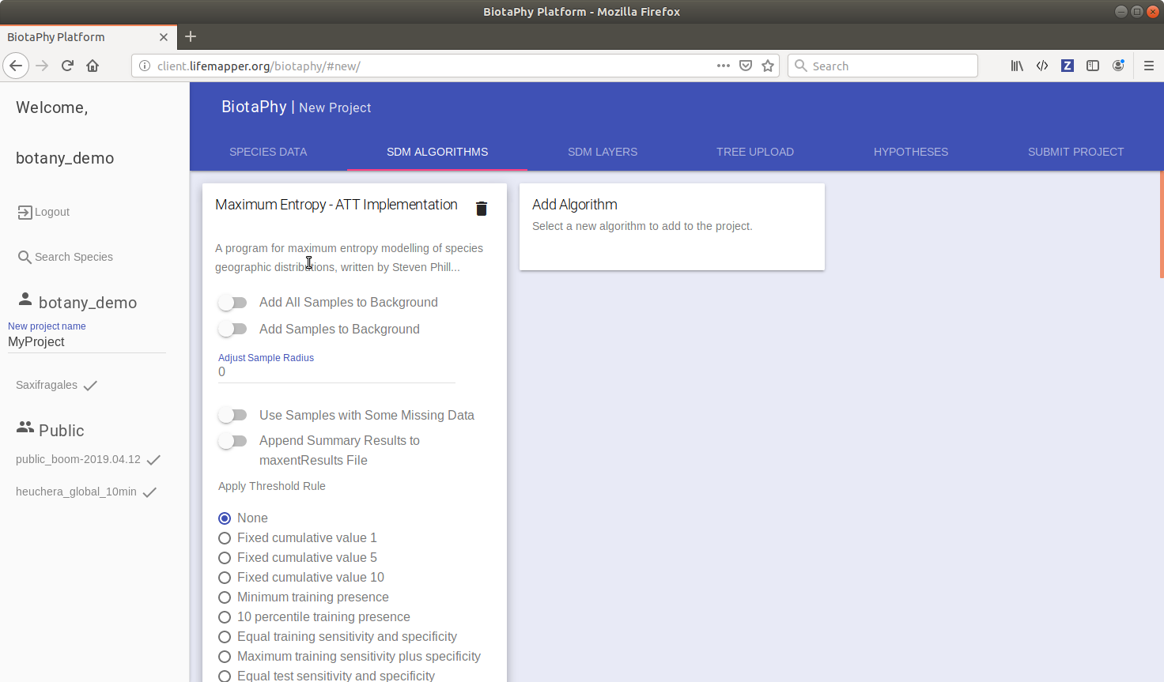
Notes:
After selecting the algorithm, you can then change the algorithm parameters it uses. Do this for all of the algorithms you want to use in your project.

Slide 42
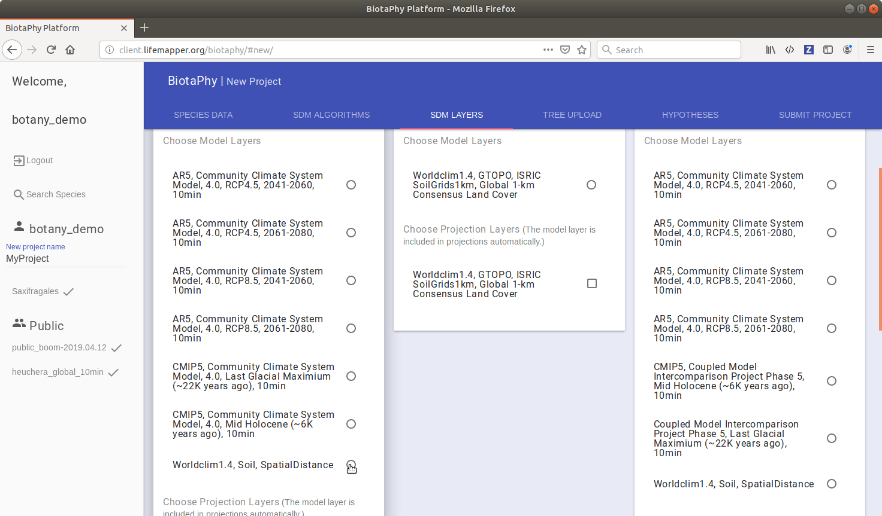
Notes:
After algorithms, you will then specify which climate layers to user for your SDMs. These options are found under the SDM Layers tab. Each card represents a climate scenario data package and all of the scenarios in that package are compatible. Meaning the model will be created from the selected scenario and then it will be projected onto the other climate scenarios you choose. The model scenario is selected via radio button and the projected scenarios have check boxes

Slide 43
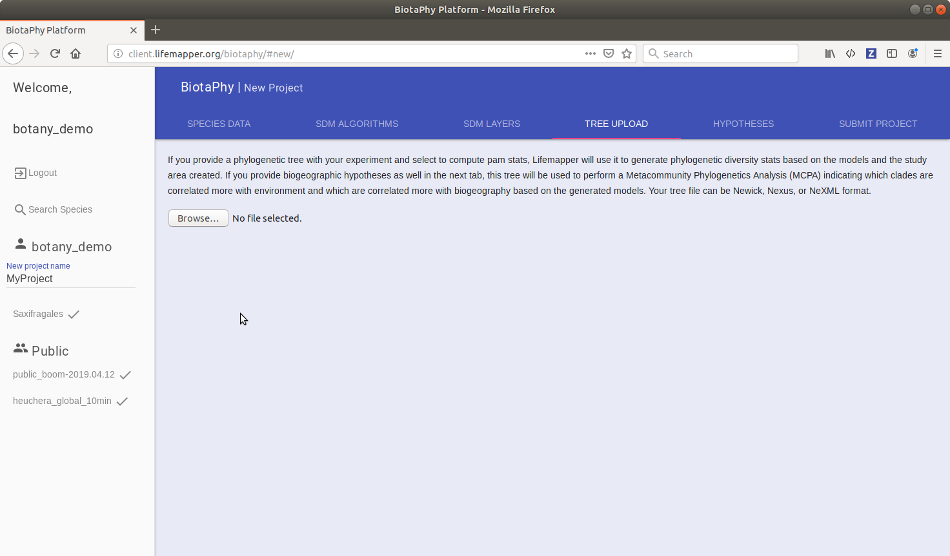
Notes:
After specifying layers, you can submit the project if you would like and only SDMs will be created. However, if you want to include multi-species analyses you may want to specify a matching phylogenetic tree. A tree is also required if you want to perform MCPA. Browse your system for the tree you would like to include and upload it.

Slide 44
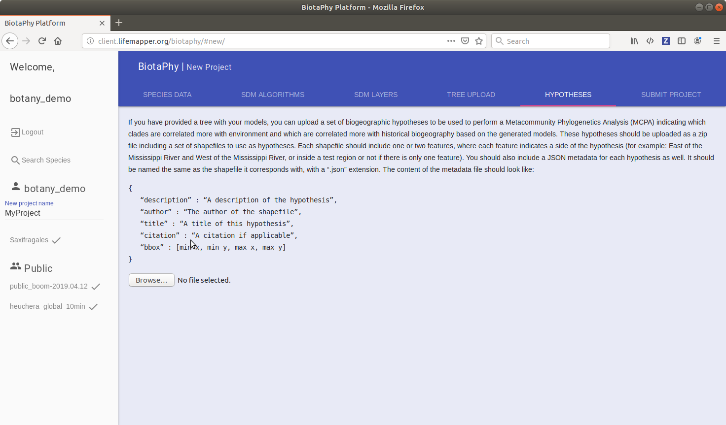
Notes:
If you want to perform MCPA, you will need to specify biogeographic hypotheses. These must be uploaded in a zip file and should include shapefiles and metadata. We are working on simplifying this process and at this time it may be easiest to contact us for assistance.

Slide 45
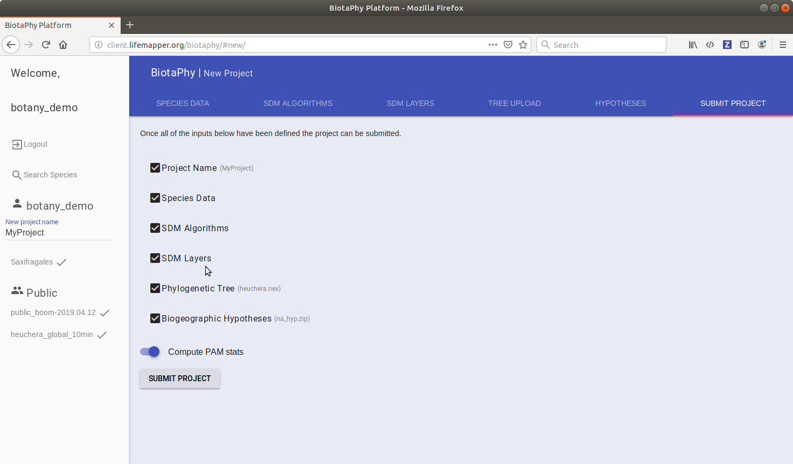
Notes:
After you have specified all of your project parameters, select the submit project tab. You will see a check list of the parameters to specify. Once all of the parameters are correctly provided, click the Submit project button.

Slide 46
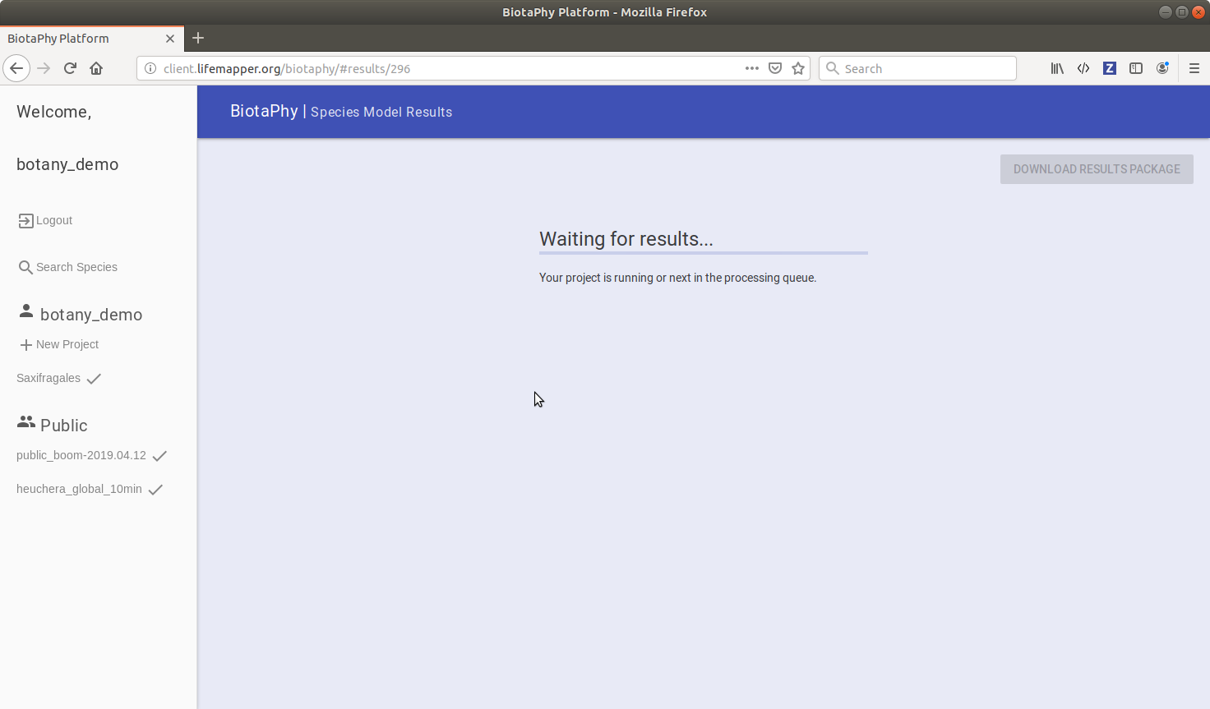
Notes:
Your project will be submitted into the processing queue for computation. At this time, you can go do something else and come back later to view your results. Your approximate position in line will be displayed giving you an idea of when your job may begin.

Slide 47
Results package
Package of the outputs from a project
Includes data and views of data
Largely offline
At this time we still require a connection for background maps but plan to eliminate that
Provide data in standard formats
So additional inspection / analyses can be done with other software
Light (but improving) metadata available indicating what each output is and how it was created

Slide 48
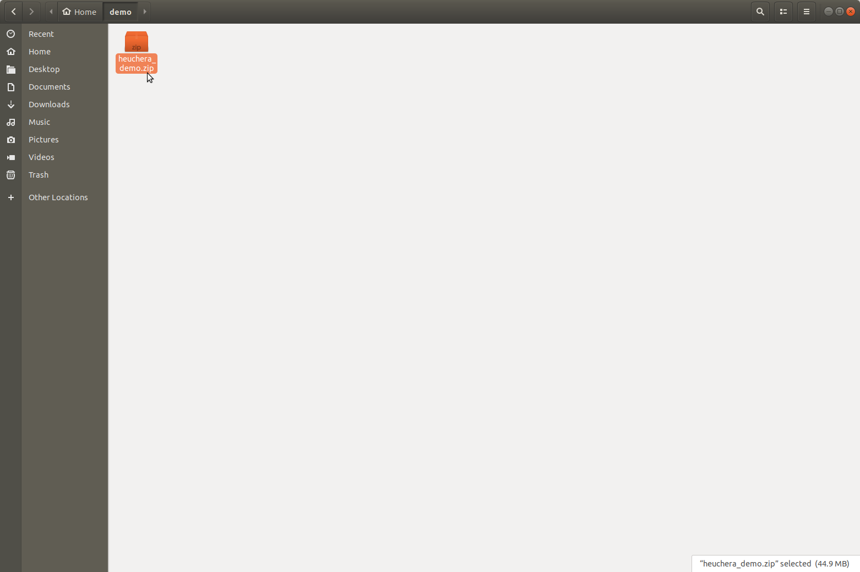
Notes:
This assumes that you have downloaded a results package. Either the one distributed for this workshop or one that you had submitted via the web UI

Slide 49
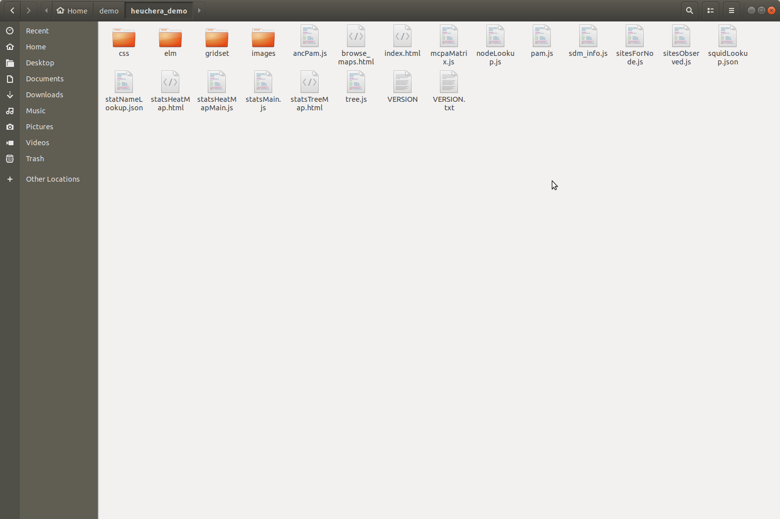
Notes:
Extract the package where you would like to on your local machine. The package consists of files for display in a web browser and also includes the data that was created in processing.

Slide 50
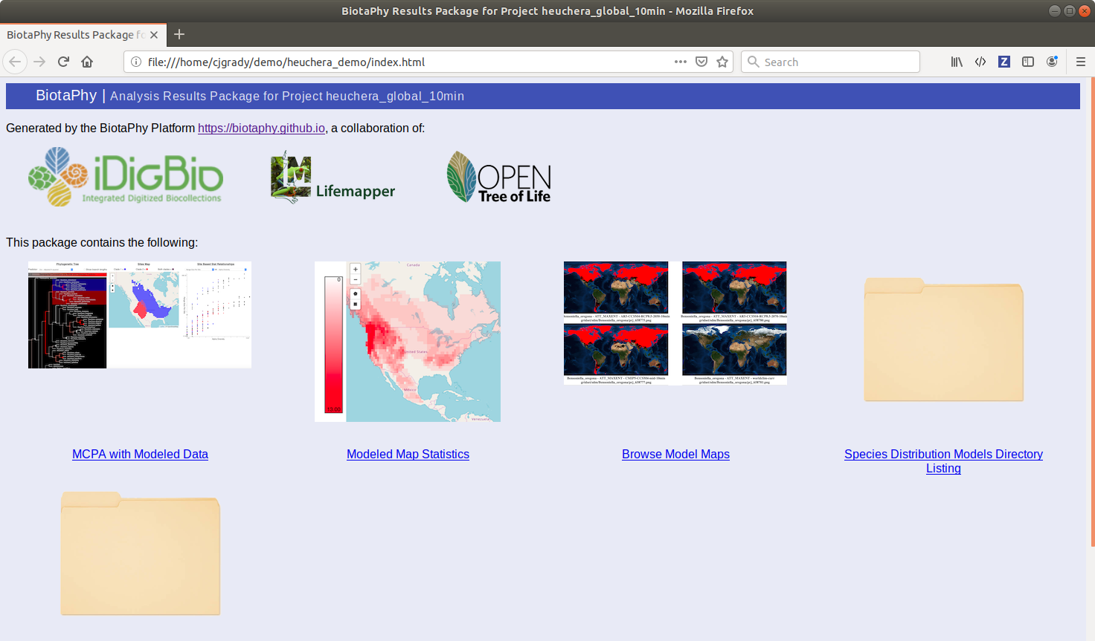
Notes:
Open the index.html page. This page provides a convenient landing spot to navigate the outputs.

Slide 51
Notes:
First we will look at MCPA with Modeled Data

Slide 52
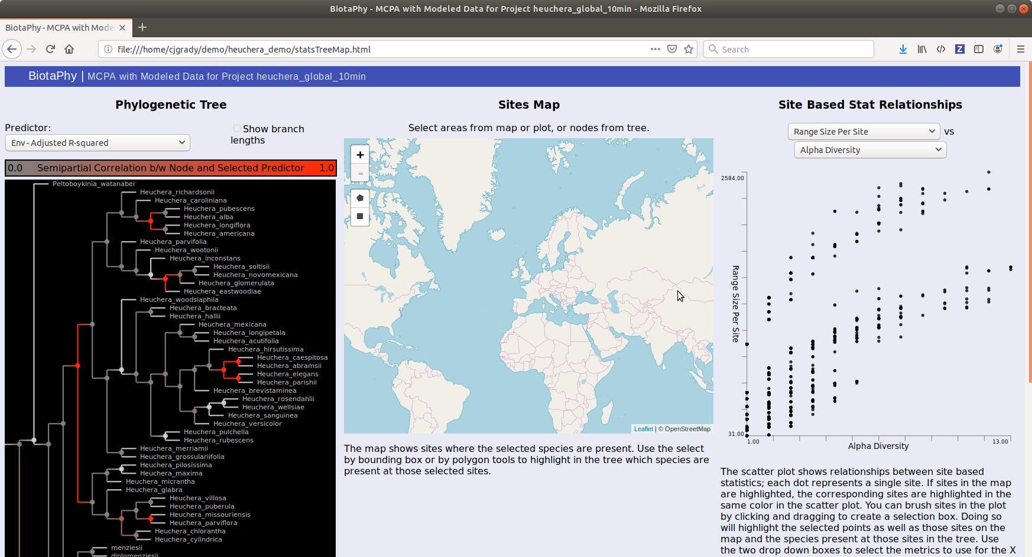
Notes:
This page has three panes. On the left, you will see the phylogenetic tree that was used in the MCPA computations. The middle pane shows a map and the right a scatter plot of site based statistics.
You can make selections in any of these panes and those selections will update the other two.

Slide 53
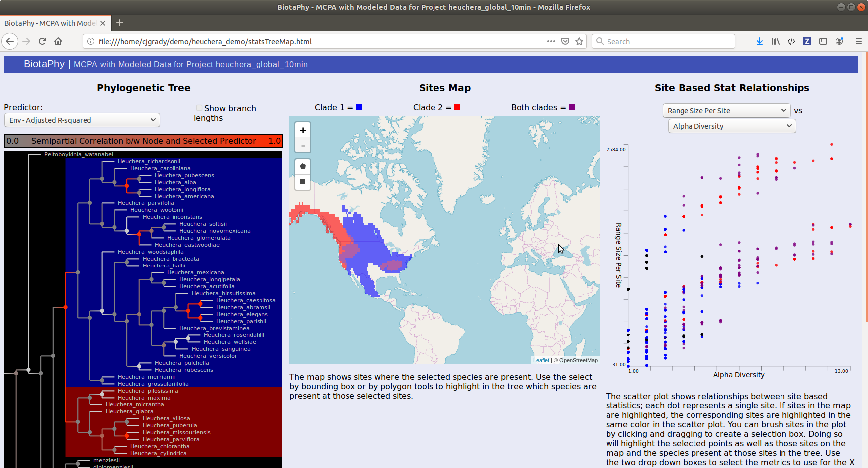
Notes:
The tree pane indicates the correlation between nodes in the tree with the selected predictor. The most useful of these predictors is Env Adjusted R squared and bio geo adjusted r squared. These give an indication if the distributions of a clade are more effected by environmental filtering or historical biogeography.
If you select one of the nodes in the tree, the map is updated to show the distributions of the sister clades of that node. One side of the clade is highlighted in blue in the tree and the distribution of those blue species is shown in blue on the map. The other sister clade is highlighted in red and the distribution of those species is shown in red on the map. Sites where species from both sister clades are present are shown in purple.
The same sites shown on the map are highlighted in the scatterplot. Red dots represent sites where red species are present, blue dots for the blue species, and purple dots where both are present.

Slide 54
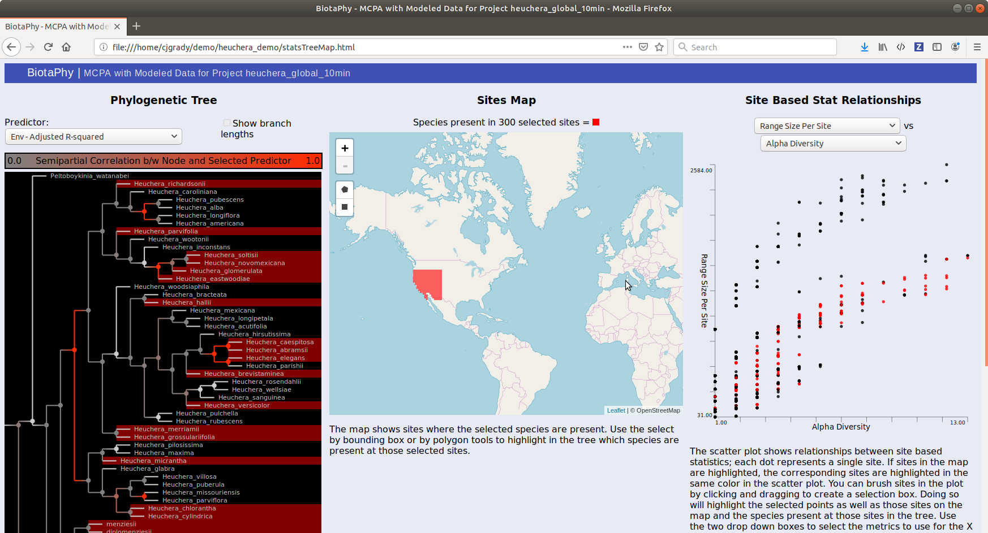
Notes:
You can also make selections via the map. You can use the rectangle or polygon select tools to select a region. Those sites are highlighted in red on the map. The species present at those sites are then highlighted in red in the tree and the sites are also highlighted in the scatterplot.

Slide 55
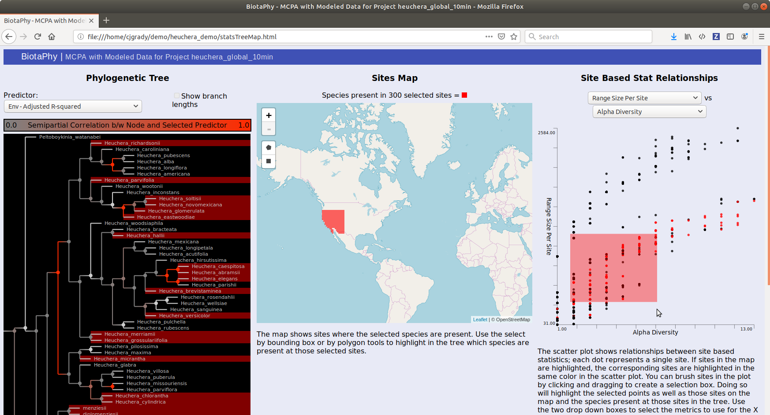
Notes:
You can also highlight sites via the scatterplot. This could be useful if there is some pattern that looks interesting, you can highlight the sites and see where they fall on the map and what species are present at those sites. This graphic shows the process of selecting sites via the scatterplot

Slide 56
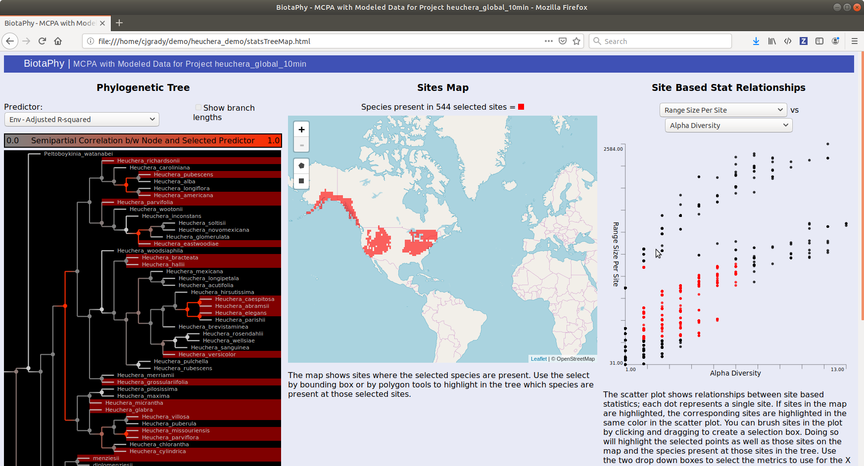
Notes:
The sites we selected in the previous slide are now highlighted in the scatterplot, the map, and the species present are shown in the tree.

Slide 57
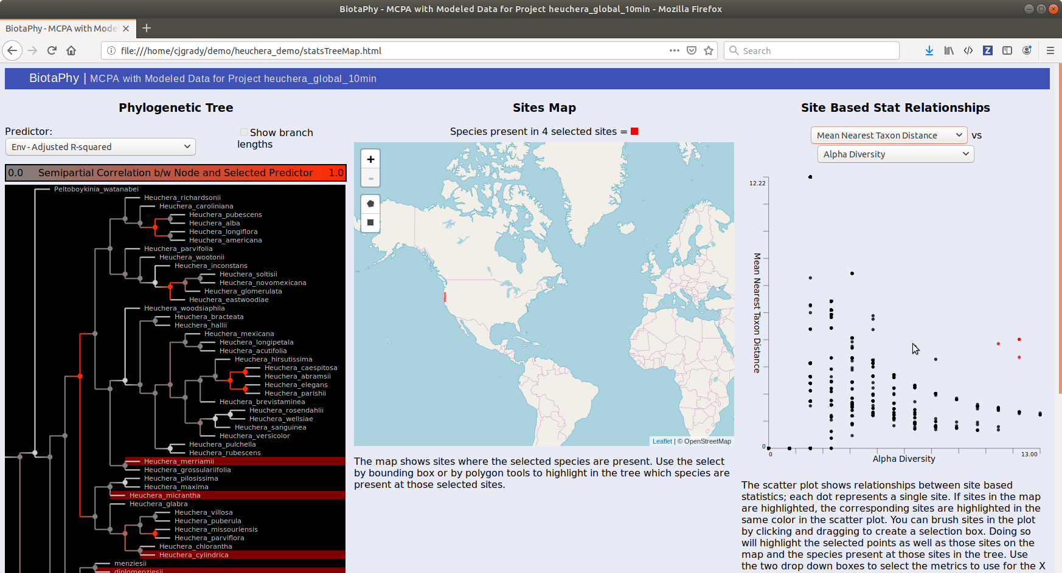
Notes:
In this example, we changed the parameters represented by the scatterplot to mean nearest taxon distance and alpha diversity. The scatterplot shows a few sites with high alpha diversity and medium mean nearest taxon distance, indicating locations with more species that are further apart phylogenetically. We have selected those sites to see where they are and they are along the west coast. We can also see the species that are present at those sites in the tree.

Slide 58
Notes:
Next, we will go back to the index page and select modeled map statistics

Slide 59
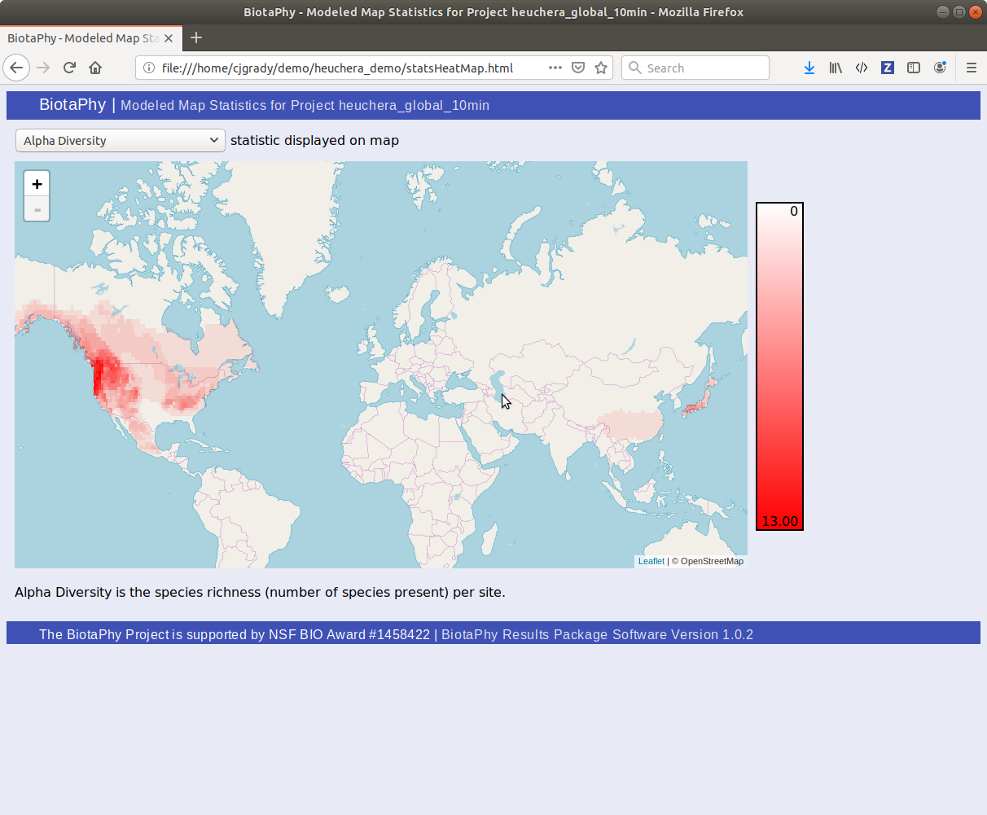
Notes:
This page shows a heat map representing a selected site-based statistic. This first example is for alpha diversity.

Slide 60
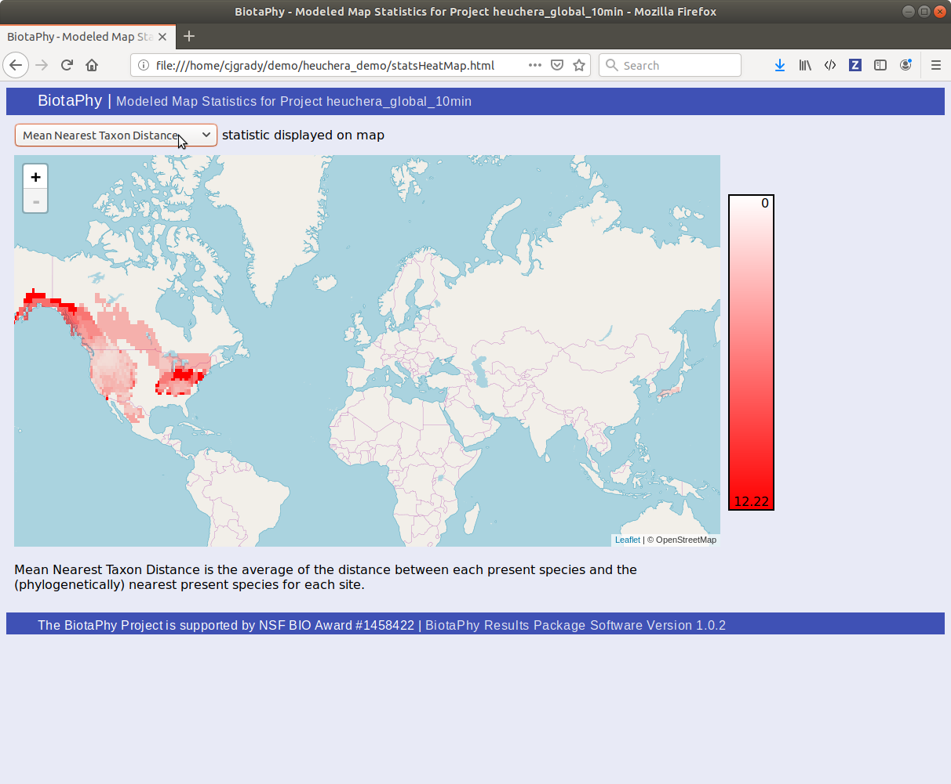
Notes:
The drop down at the top left allows you to select different site-based statistics and see where the values are higher and lower spatially. This example is for mean nearest taxon distance

Slide 61
Notes:
We include SDM maps in the package. Back on the index page, select browse model maps.

Slide 62
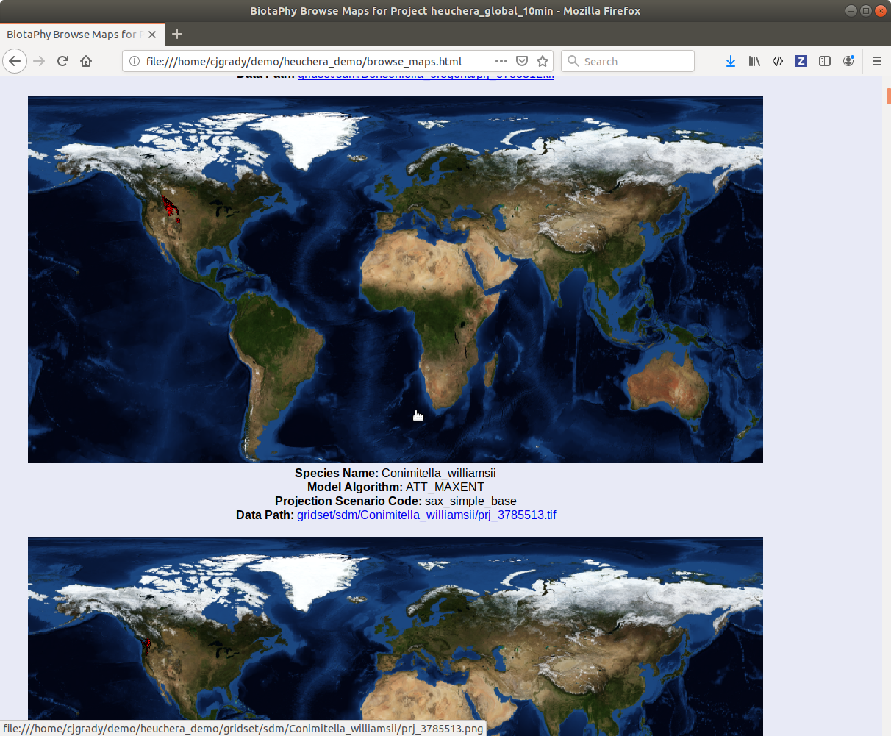
Notes:
This page shows images for each of the projections in the package along with metadata. At this time, these maps are static. You can also directly navigate to the raster data used to create the images.

Slide 63
Notes:
You can instead navigate to the SDM data from the directory listing under species distribution models directory listing

Slide 64
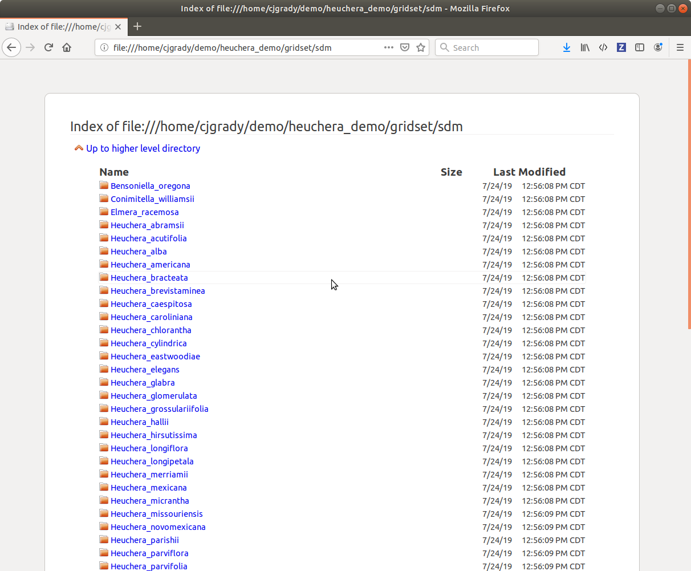
Notes:
The top level of this listing groups data by species.

Slide 65
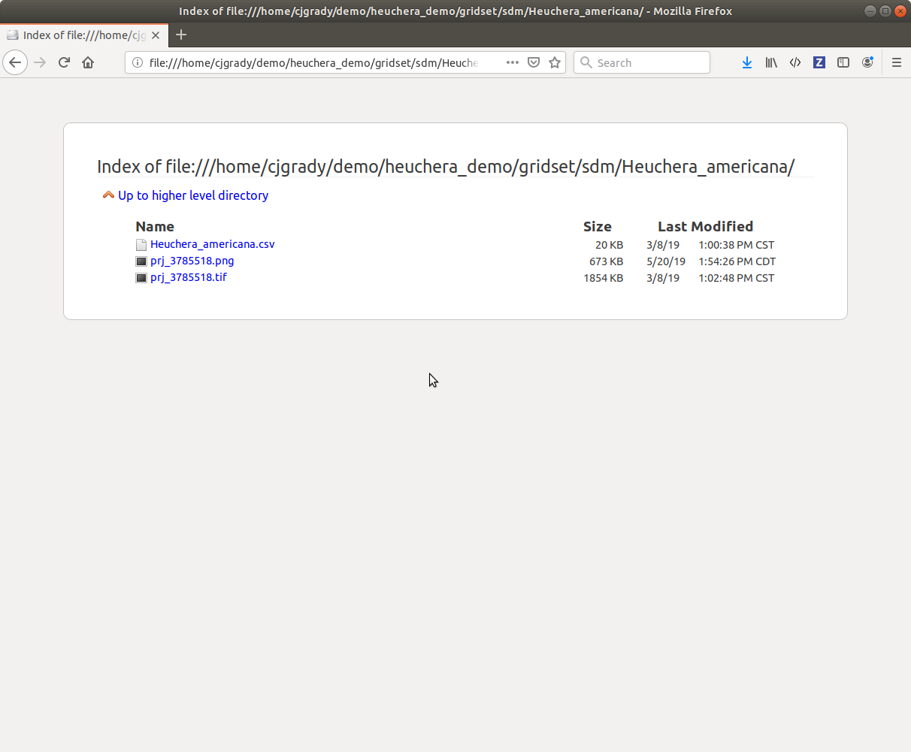
Notes:
Within each species sub directory is all of the data in the package for that species. If you selected multiple algorithms and / or multiple projection scenarios, all of those projections would be found here along with the occurrence points for that species.

Slide 66
Notes:
Finally, we provide a directory listing for the CSV data created by the analyses (sorry the image is cut off)

Slide 67
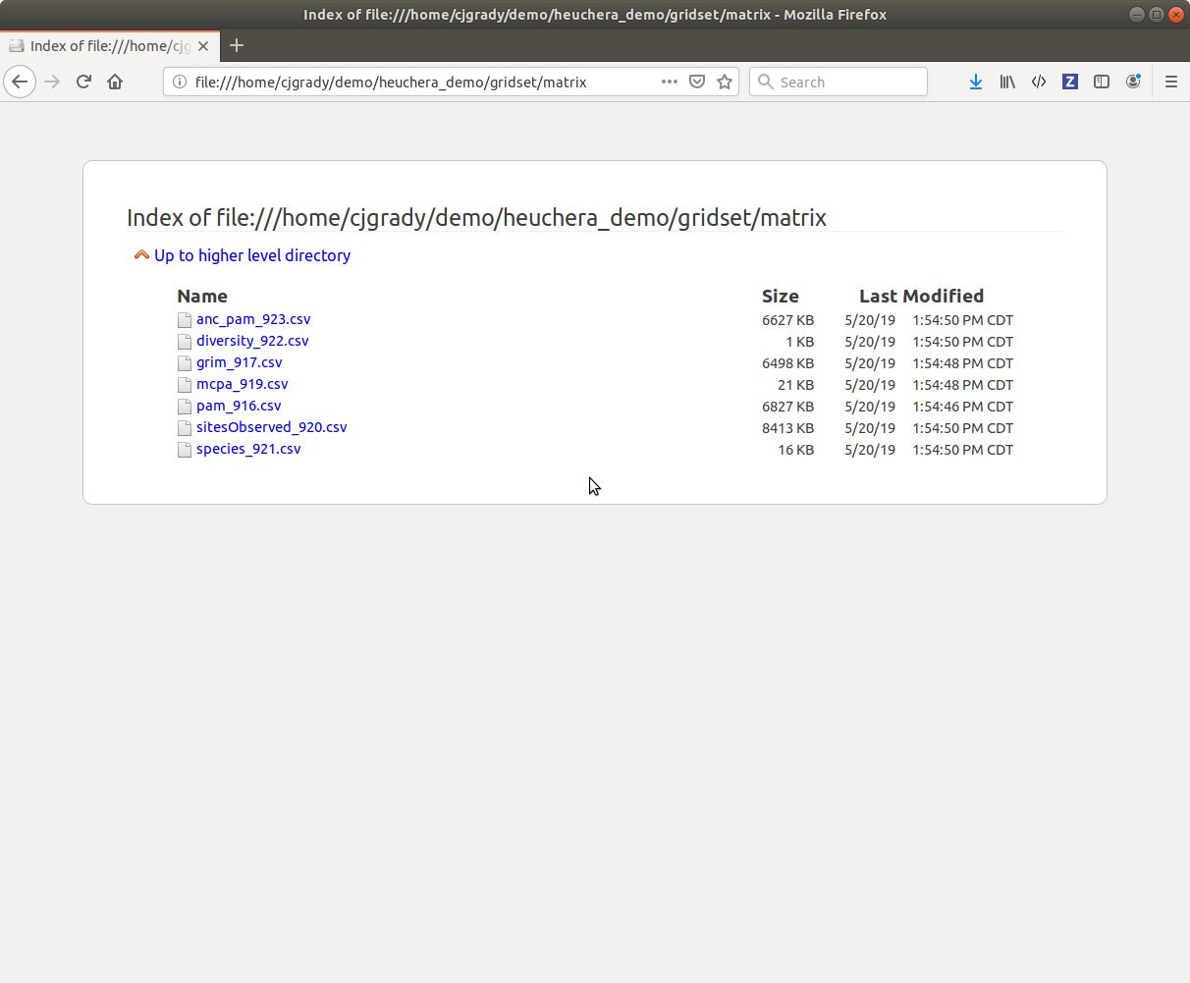
Notes:
This directory lists the multi-species statistics and data structures computed by the project in a format that can be used by other software.

Slide 68

BiotaPhy Analyses Repository
Open source and on GitHub
https://github.com/biotaphy/biotaphypy
A place for community contributed analyses
Provides computational power by deploying on Lifemapper cluster resources
Builds on Lifemapper objects and architecture (lmpy)
Python
Notes:
The BiotaPhy analyses repository is a place for community engagement. Researchers and developers can contribute their analyses for use by the community and BiotaPhy developers will help optimize them for our architecture. We also provide smaller tasks for new developers, or just those new to Python, to help improve their skills and help them start contributing to open source projects.
The repository is peer reviewed via pull requests and utilizes tools such as continuous integration via Travis CI and testing tools to ensure that the code is consistent and reliable.

Slide 69
Coming Soon!
Integration with Specify
Enable easier access to research computation tools
Data cleaning and acquisition services
Easily incorporate data from aggregators
Data filters
Data modifiers

Slide 70
Key Points Revisited
Easy to use, flexible tools for data cleaning
How Biotaphy facilitates scaling
What you can do with cleaned data
Outputs of computations
Community additions
What’s next

Slide 71





Lifemapper Biotaphy work funded by:
US NSF
NSF / BIO / DBI - 1930005
USGS
BIP-G14AC00285
Notes:
This work was funded by the United States National Science Foundation and Geological Survey

Slide 72
Questions?
Questions?
Want to try it out?
https://lifemapper.github.io/lmpy/
http://client.lifemapper.org/biotaphy/
Email me: cjgrady@ku.edu

